Slide 1

Effective early intervention: using initial performance to assess graduation outcomes
Shalon, Swetha, Tung

Slide 2
Student outcomes are important to everyone involved
College is a significant personal and financial investment
College education outcomes are relevant to students, advisors, and school administration
Problem: outcomes are far ahead in the future
And depend on many existing challenges: financial stress, previous education, family support, cultural adjustment, etc
Objective: Predict college outcomes (Graduate, Dropout, Enrolled) for a sample of first-year college students

Slide 3
Data helps us look into various attribute groups that may determine college success
Dataset: 4424 records of first-year students in 2008 - 2018 period
Target: status at 4-year(Graduate, Enrolled, Dropout)
Attribute (31) groups:
Demographics
Previous education background
Notes:
Realinho, V., Machado, J., Baptista, L., & Martins, M. V. (2022). Predicting Student Dropout and Academic Success. Data, 7(11), 146.

Slide 4

Data helps us look into various attribute groups that may determine college success
Socioeconomic:
Reflect important challenges (financial stress, unemployment, family background, etc…)
First-year performance
curricular units credited, enrolled, evaluated and approved, as well as the grades
1st and 2nd semester

Slide 5
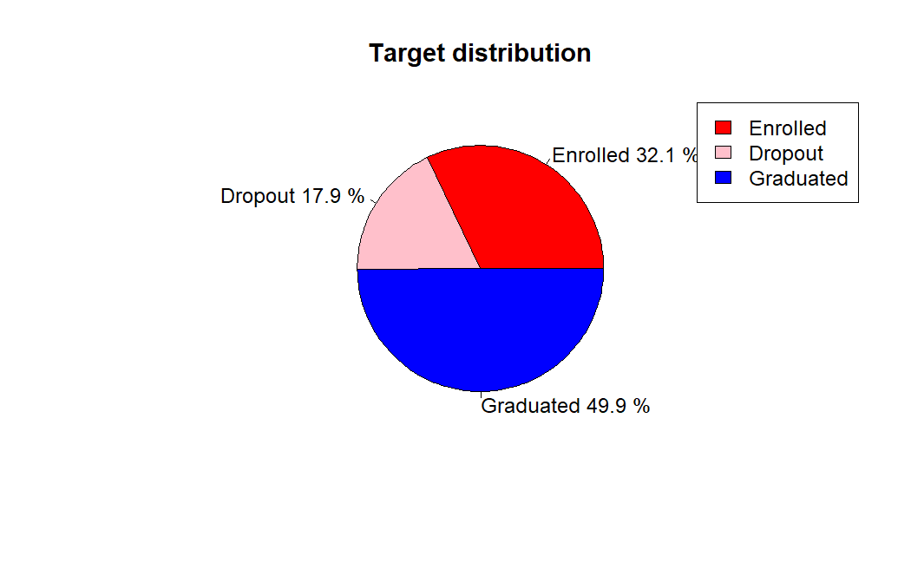

Slide 6
Central question: Can we provide intervention strategies for high-risk students, and how early?
Main objective: Predict student status, especially dropout students
Assess whether 2nd semester data is necessary - provide earlier intervention
Approaches:
Random Forest
LightGBM

Slide 7
Data Preprocessing
- Removed unnecessary columns: Focused on credits evaluated, approved, and final semester grades by dropping irrelevant columns.
- Encoding categorical data: Converted target variable and other columns to numeric types for compatibility with machine learning algorithms.
- Handling high cardinality columns: Temporarily dropped high cardinality columns to simplify the dataset and reduce overfitting risk.
- Filtering Application order: Excluded rows with "0" and "9" levels for a cleaner dataset.

Slide 8
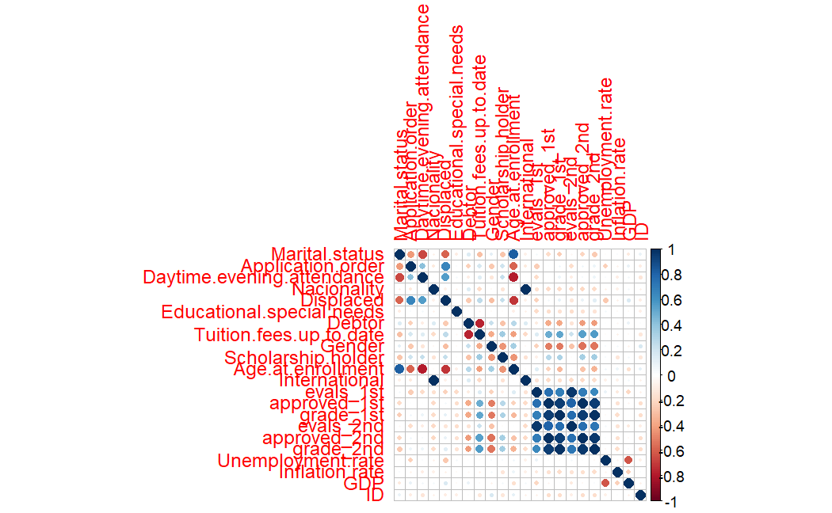

Slide 9
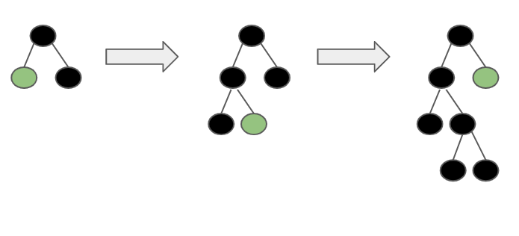
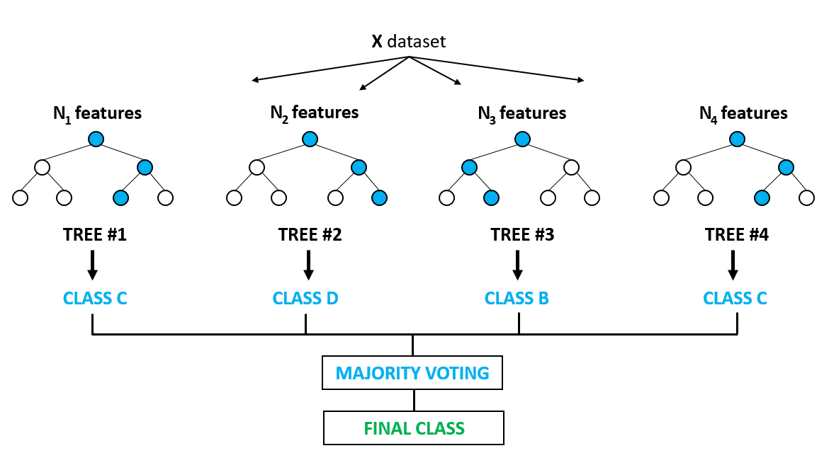
Methods overview
LightGBM
A more efficient way to perform gradient boosting
Save time on large datasets or large grid search spaces
Random Forest
Combines multiple decision trees to reduce overfitting and improve prediction accuracy.
Handles large datasets efficiently and effectively, maintaining high performance even with many input features.

Slide 10
Performance with all variables
LightGBM: accuracy 73.16%
Important variables: completed credits (both semesters, up to date tuition, and age at enrollment)
Random Forest: accuracy 72.03%
Important variables: completed credits (both semesters, and age at enrollment)
Which model performs best?
LGBM performs best out of the two models implemented.
Good performance for dropout, graduate, lower performance for the middle category (Enrolled)
Notes:
Now I am gonna talk about the performance of the models with all the features selected, lgbm gave a performance of 75.8% and by calculating the feature importance we found that completed credits for both the semesters, timely payment of tuition and age at the time of enrollment are the features that are most significant
Now I am gonna talk about the performance of the models with all the features selected, gave a performance of 77.4% and by calculating the feature importance we found that completed credits for both the semesters, and age at the time of enrollment
are the features that are most significant
From this we can understand that random forest performs best out of the two models implemented and
we also analysed that the models gave a good performance for labels 0 and 2 that is dropout and graduated and we got a lower performance for the 2nd target dropout

Slide 11
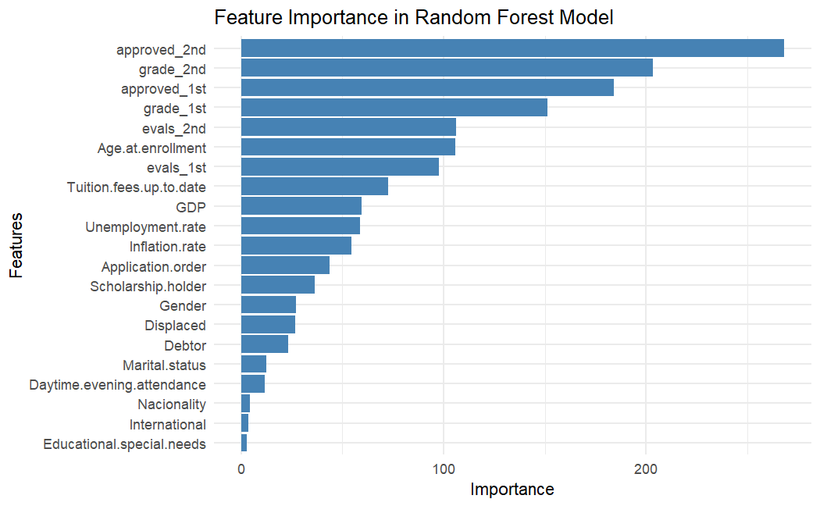
Notes:
Here we have the figure for feature importance and on the x axis you can see the importance and on y axis we have the features in the random forest model and here we can see that approved credits and grade approved are the most important features
Age at enrollment is also a significant feature and we will see the target plotted against the feature in the next slide

Slide 12
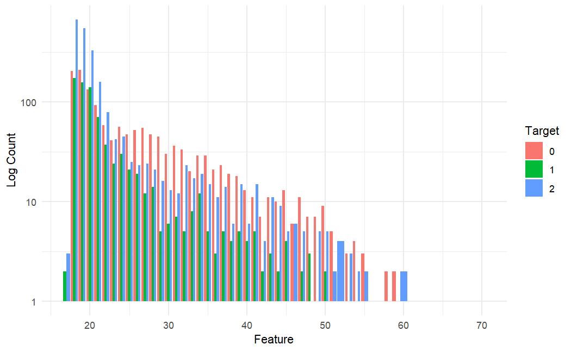
Log(Target) by Age at enrollment
Notes:
In this graph we can see that all three of the targets are heavily populated in the age group 17 to 26-27 and as the age increases we can see that all 3 of the targets are decreasing

Slide 13
Performance without 2nd semester data
LightGBM: accuracy 71.9%, down by ~4%
Important variables: approved credits, grades, up to date tuition, age at enrollment, and scholarship holder
Random Forest: accuracy 72.03% down by ~5%
Important variables: approved credits, up to date tuition, scholarship holder, age at enrollment, grades
=> It is possible to predict outcomes after just one semester!
Notes:
We also did a little analysis of our own to see if we can do some intervention and prevent the students from dropping out as early on in their second semester so we eliminated the 2nd semester data and considered only the first semester data and we got an accuracy of 71.9% for lgbm which is 4 % less than what we got including the 2nd semester data and for random forest we got a 5 % less accuracy than that we got with the 2nd semester data and we came to a conclusion that it is possible to predict outcomes after just one semester

Slide 14
Conclusion
Intervention for high dropout risk students is viable, even with one semester data.
Financial stress is the main social determinant of dropout
Non-traditional students, particularly older ones, may require different educational approaches.
Develop strategies to address social and accessibility barriers for non-traditional students.
Effective early interventions can improve graduation rates and help students achieve academic goals.
Notes:
We can take actions on high risk dropout students at a very early stage of their completion 1st semester, we can use just one semester data to implement measures to prevent the students from dropping out
Financial stress is a main factor that impacts the dropout rates This point means that financial stress is a significant factor that affects a student's ability to succeed in college and complete their degree. Students who face financial difficulties such as high tuition fees, living expenses, and lack of financial support are at a higher risk of dropping out of college. By addressing these financial stressors through financial aid, scholarships, and other forms of support, colleges and universities can help alleviate financial burdens and improve graduation rates.
non-traditional students may face, such as work or family responsibilities, financial challenges, or lack of access to resources. By addressing these barriers, colleges and universities can increase the likelihood of non-traditional students graduating and achieving their academic goals.
For the future scope of the project
Personalized Learning: By identifying which students are most at risk of not graduating early on, personalized interventions and support can be provided to help them stay on track. Machine learning models can help identify which interventions are most effective for which students, leading to a more targeted approach.
Schools and education systems can use the insights gained from machine learning models to allocate resources more effectively. By identifying which schools or classrooms are struggling the most with graduation rates, additional resources can be provided to those areas to help support student success.
Machine learning models can help inform policy decisions related to education. For example, policymakers can use these models to identify the factors that most strongly predict graduation outcomes, and develop policies that address these factors.
machine learning methods to assess graduation outcomes can also lead to new insights and understanding of how various factors impact student success.

Slide 15
Do you have any questions?
THANK YOU :)

